Slide 1

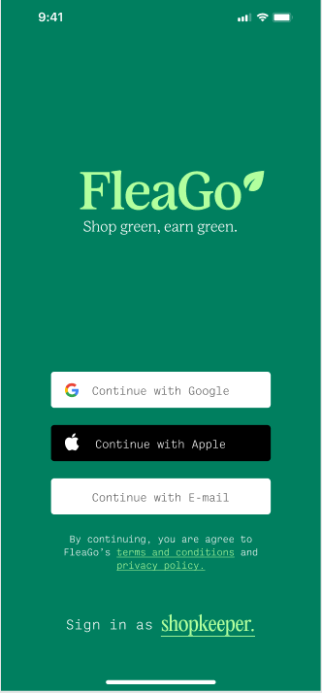
FleaGo
Your One Stop Fleamarket App

Slide 2
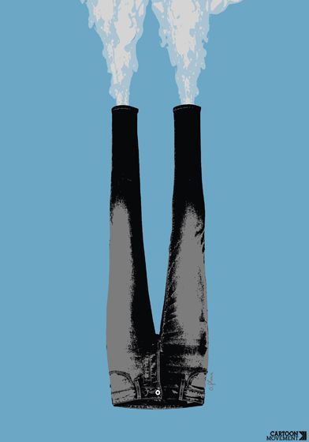
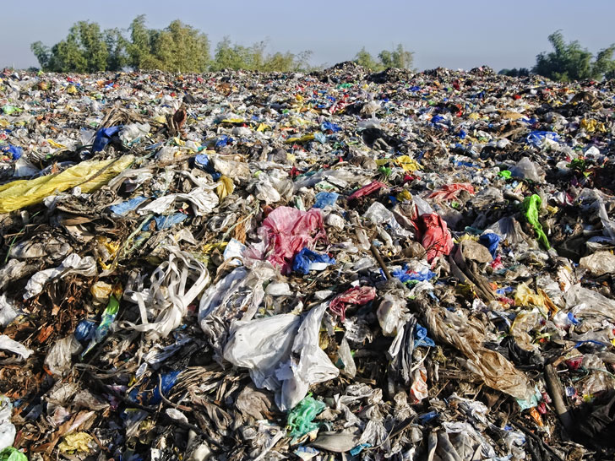
How to help Decarbonisation
The fashion industry accounts for
8-10% of global carbon emissions
We can CHANGE this!
“UN Environment Programme”

Slide 3
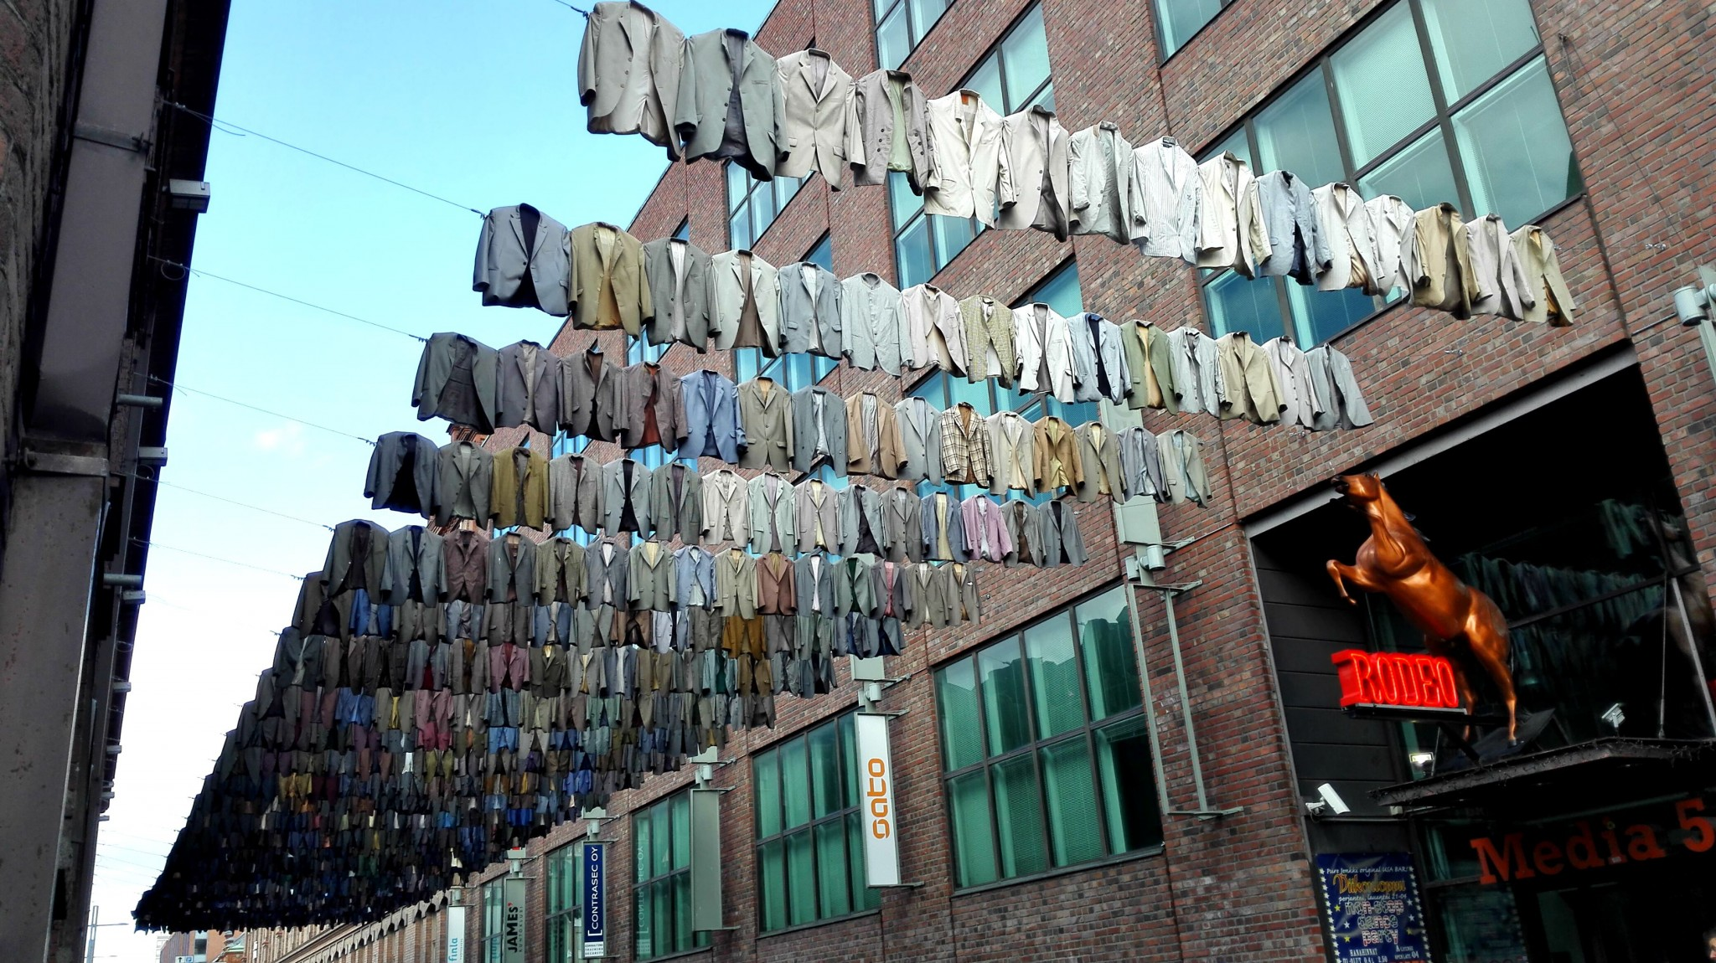
Climate Heroes Must Be Rewarded!
People love Flea Markets!
Fun but demanding!
A reward system could help!

Slide 4
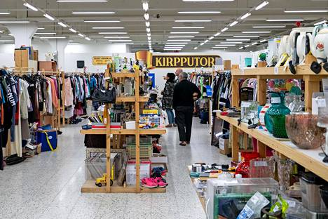
Tampere Flea Markets
Kirpputori or Kirppis is often in a fixed location
“Flea Market owner”
“Individual seller”
“Customer”

Slide 5
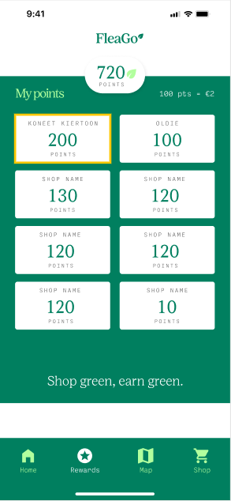
What’s FleaGo
A rewarding app for the customers
Points → goods.
“Market owner” → monthly subscription
“Customers” → free access & unique QR code

Slide 6

Why use FleaGo
Points benefit customers
Market owners get more purchases
Circular economy is empowered
No extra equipment needed
Proven record in other sectors

Slide 7


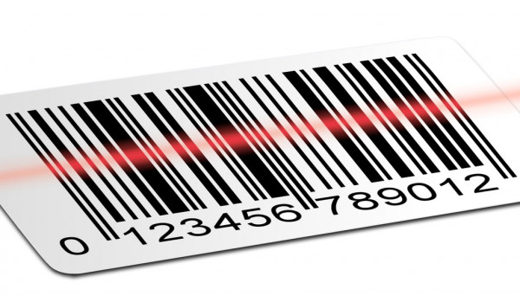

FleaGo’s Future
Short term subscription and advertisement
Gold membership & IoT device
Item barcodes
Plugins

Slide 8
Business Model
Monthly subscription
Short term subscription
Advertisements

Slide 9
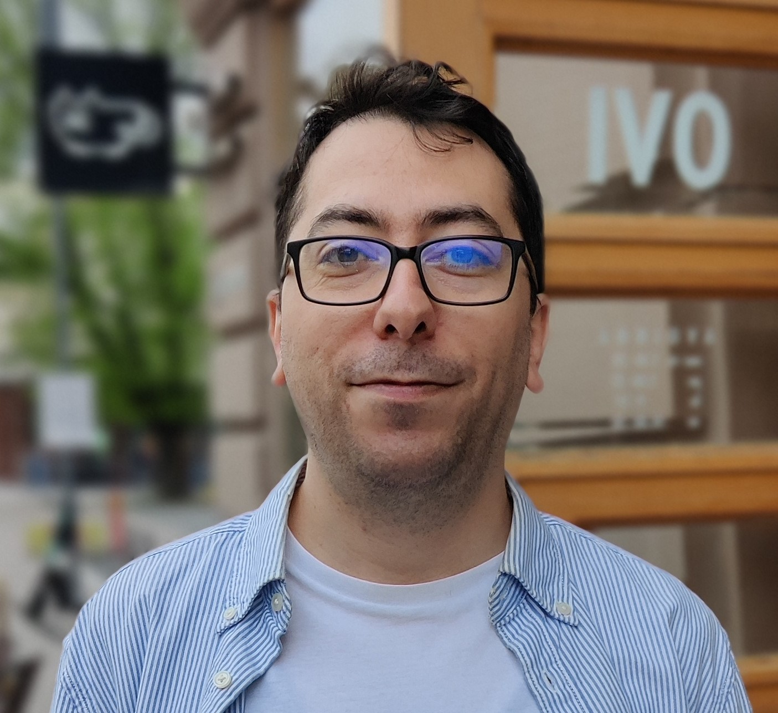

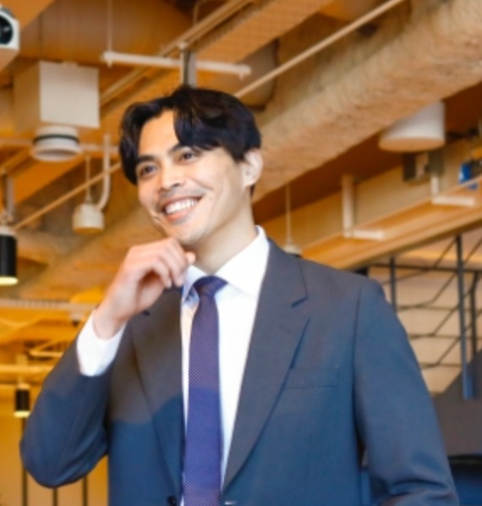
The Team
Sina Deznabi
Pranav (Van) Pradeep
Adrian Luna

Slide 10
Thank You!

